Slide 1
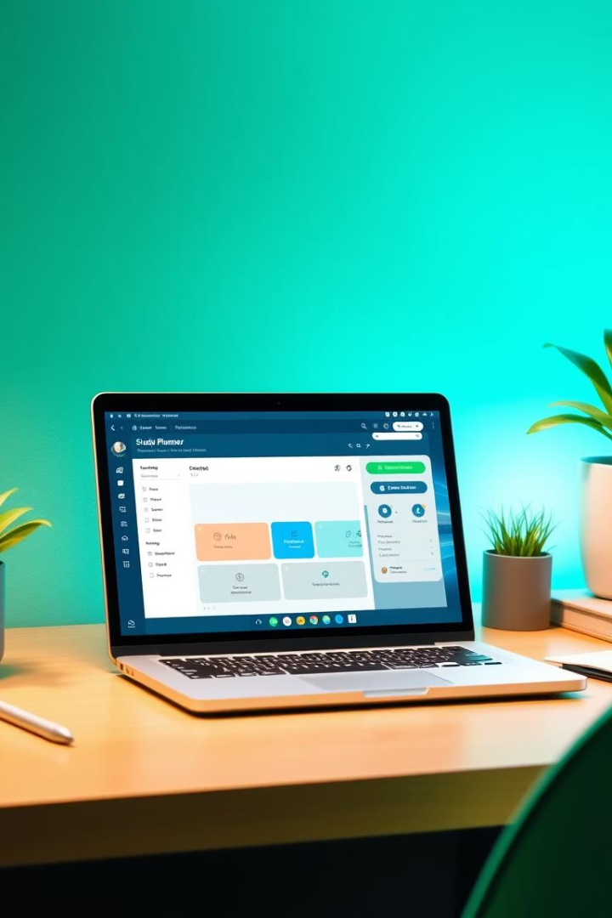
AI-Based Study Planner
Presented by: TUSHAR, MAINPAL, PORAS, SWAYAM
Transforming syllabus into personalized study plans efficiently.

Slide 2
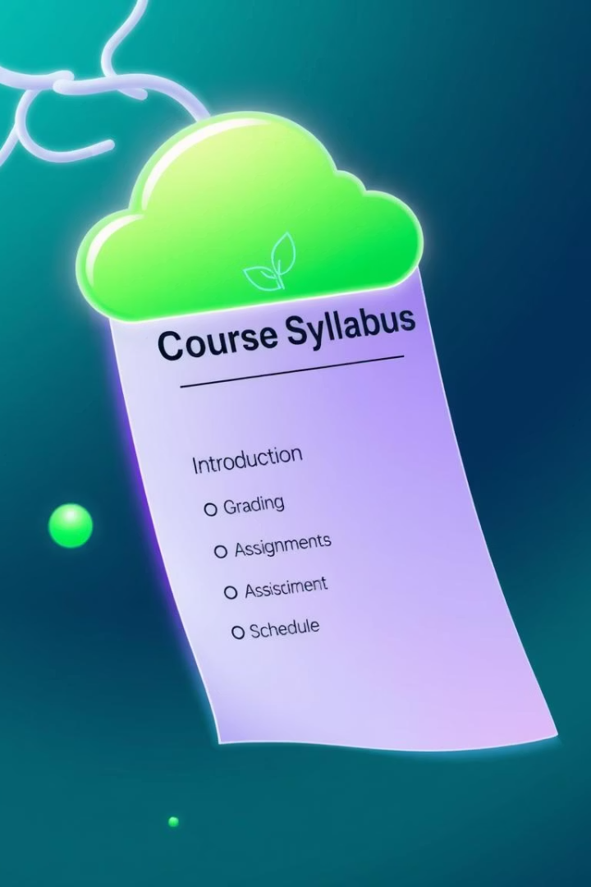
Project Overview
Objective
Automate study planning from syllabus input.
Key Features
Upload syllabus (PDF/TXT)
Extract topics automatically
Generate personalized schedule
Recommend relevant YouTube videos
TUSHARKAPOOR

Slide 3
Backend Architecture
Framework
Core Modules
Built with Flask (Python), lightweight and scalable.
app.py: Main controller
syllabus_processor.py: Extracts topics
scheduler.py: Generates study plan
video_recommender.py: Fetches video links
TUSHARKAPOOR

Slide 4
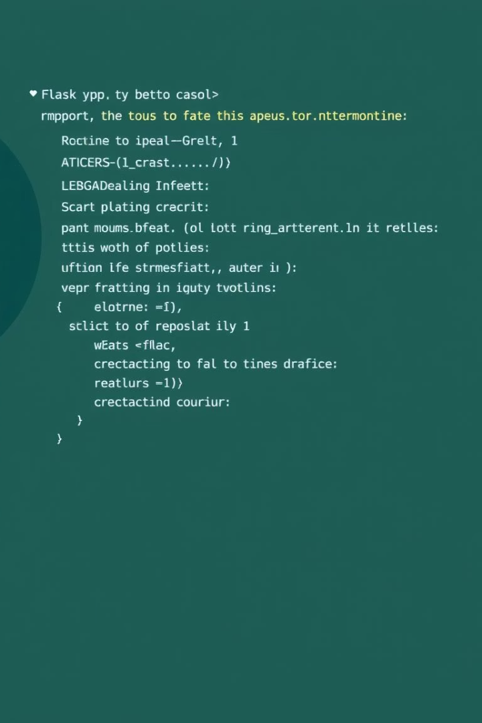
app.py – Application Controller
Responsibilities
Integration
Manages routing, file uploads, user sessions.
Bridges frontend interface with backend logic.
Libraries Used
Flask, pdfplumber, werkzeug, os, secrets for security.

Slide 5



syllabus_processor.py
extract_topics(text)
Output
Parses and cleans syllabus text input.
Returns structured list of key topics for scheduling.
TUSHARKAPOOR

Slide 6
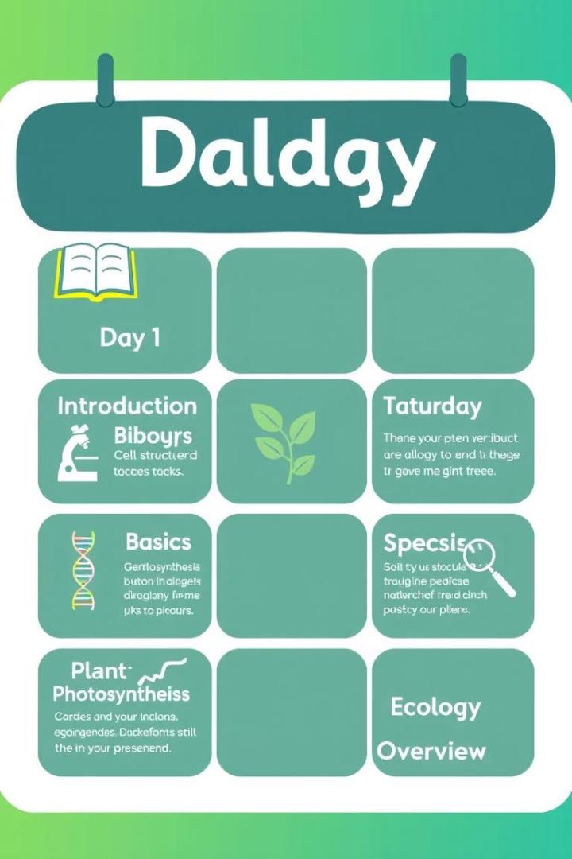
scheduler.py
generate_schedule(topics)
Distributes topics evenly over five days.
Output Format
Dictionary with day keys and topic lists as values.

Slide 7
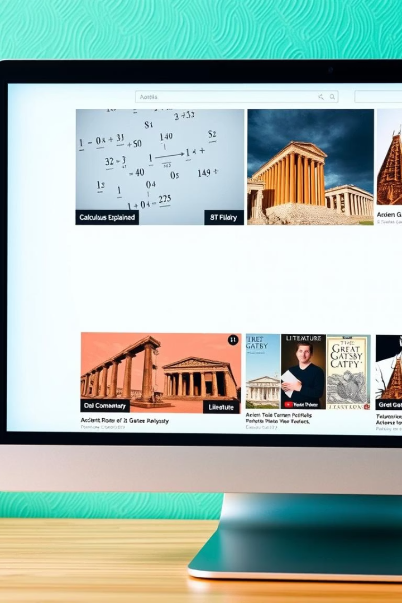
video_recommender.py
recommend_videos(topics)
Generates YouTube search links for each topic.
Learning Enhancement
Supports understanding with curated educational videos.

Slide 8
Frontend Overview
Technology
Key Pages
Built with HTML, CSS, and Flask templates for dynamic content.
index.html: Welcome page
upload.html: Upload syllabus
dashboard.html: View topics and videos
result.html: Display study plan
TUSHARKAPOOR

Slide 9
User Workflow
1
2
3
Upload Syllabus
Extract Topics
Recommend Videos
4
5
Generate Study Plan
Review & Follow
TUSHARKAPOOR

Slide 10
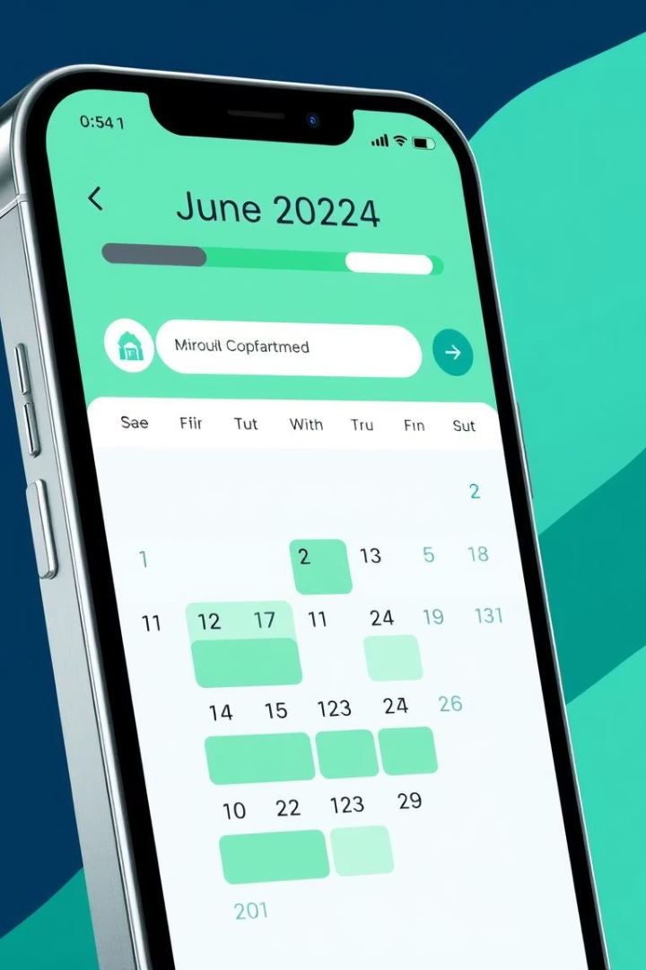
Conclusion and Next Steps
Current Impact
Automates and simplifies study planning effectively.
Future Enhancements
Calendar integration for scheduling
Progress tracking and analytics
Advanced topic categorization
TUSHARKAPOOR

